Slide 1
2D Colossi Arena
A game produced by Alex Mitchell, Jack Maber, James Collins and Kieran Goldsworthy

Slide 2
High Concept
2D Colossi adventure is a 2D Platform Action boss fighting game.
The main focus of our game was to bring large intimidating boss fights from 3D games to 2D with a nostalgic art style.
Main idea we had was to have aspects from Shadow of the Colossus to the art style of The Legend of Zelda II.
The prototype consists of a title screen and a boss fight which shows the main mechanics of our game.

Slide 3
Target Audience
Targeting young males between the ages of 16-30
Low price is more likely to appeal to the casual gamer
Someone looking to kill time or have some harmless fun
Final version would include a time attack mode and multiple difficulties for competitive aspect

Slide 4
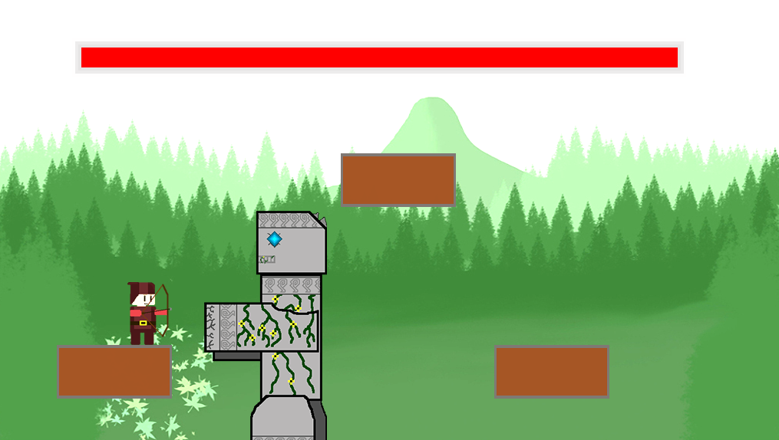
Aesthetic
Went for an ‘old school’ pixel art look with hit sparking.
Easy to understand for ‘pick up and play’ capabilities due to clear hud including large health bars for both player and boss.

Slide 5
Unique selling points
The USP of our game is the merging of the huge bosses to 2D.
Easy to play, keeping the player from being frustrated and to have fun. Difficulty is also key to this.
We have plans to add more into the game that rewards the player. For example, better weapons or power ups in the final game.

Slide 6
Similar games on the market
Sonic boss battles
Super metroid
Kirby nightmare in dreamland boss fights
No true pricing can be determined but similar games on the steam market range from £3-12
Shadow of the colossus £30 on release

Slide 7
Game Mechanics
Jumping, shooting Projectiles
Health bars for player and enemy characters
Boss AI and movement

Slide 8
Technical and Production Feasibility
Relatively simple art style means not very resource heavy Reusability of art assets leads to easy production of said assets Made in Pygame with python 2.7 interpreter Prototype means we can give a timescale for the finished game Slightly over scoped this project as we have a few features missing

Slide 9
Technical and Production Feasibility
Prototype means we can give a timescale for the finished game Slightly over scoped this project as we have a few features missing Plan to sell at £2.99 a unit with the amount of current work we plan to have done

Slide 10
Commercial Feasibility
A few similar games or games with boss fights similar to 2D colossi arena’s have had great success.
Could branch onto other platforms with ease and would suit it well as game is not demanding on the hardware.
Widened target audience and adapts to what people want to play it for.

